Slide 1

Neurophysiological Correlates of Sleep: Investigating Brain Activity Patterns and How it Impacts Health Outcomes
Update Presentation
Team: Sleeping Beauty
Team members: Lisong He, Bowen Deng, Iuliia Dmitrieva, Kaixuan Zhang
02/04/2024

Slide 2
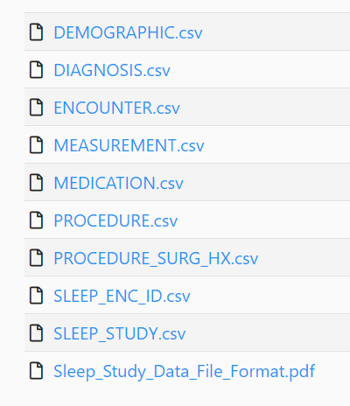
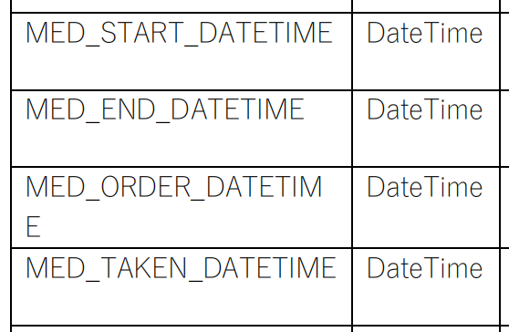
Data Update
•9 csv files and more than 70 indexes
•uncorrelated indexes like “time entered the hospital”

Slide 3
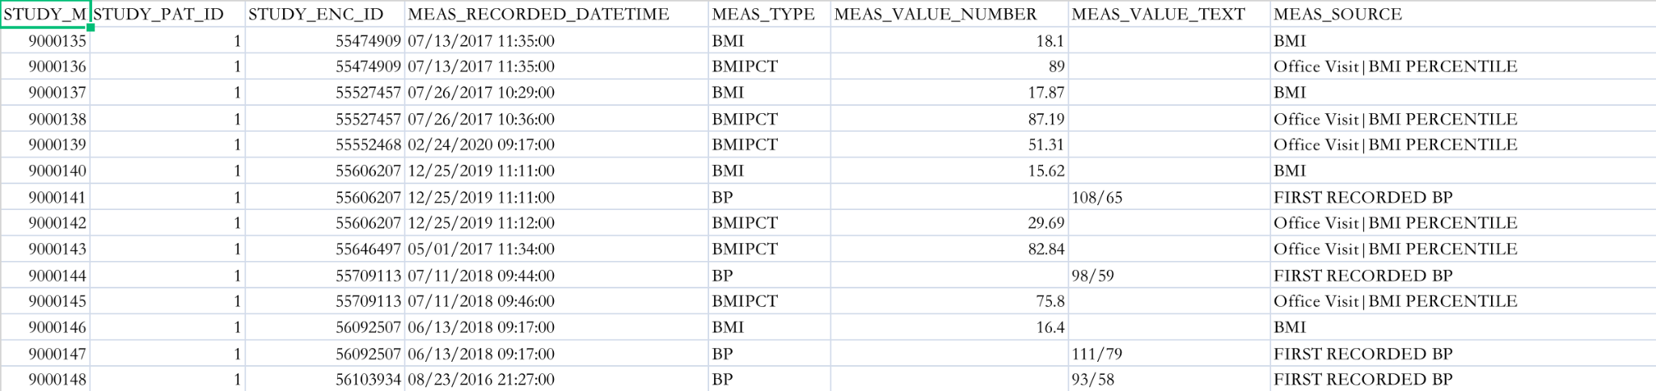
Data Update
•pick up indexes that we are interested in: BMI, Blood pressure, Age, etc.
•obstacle in concatenation (cross multiplication)

Slide 4
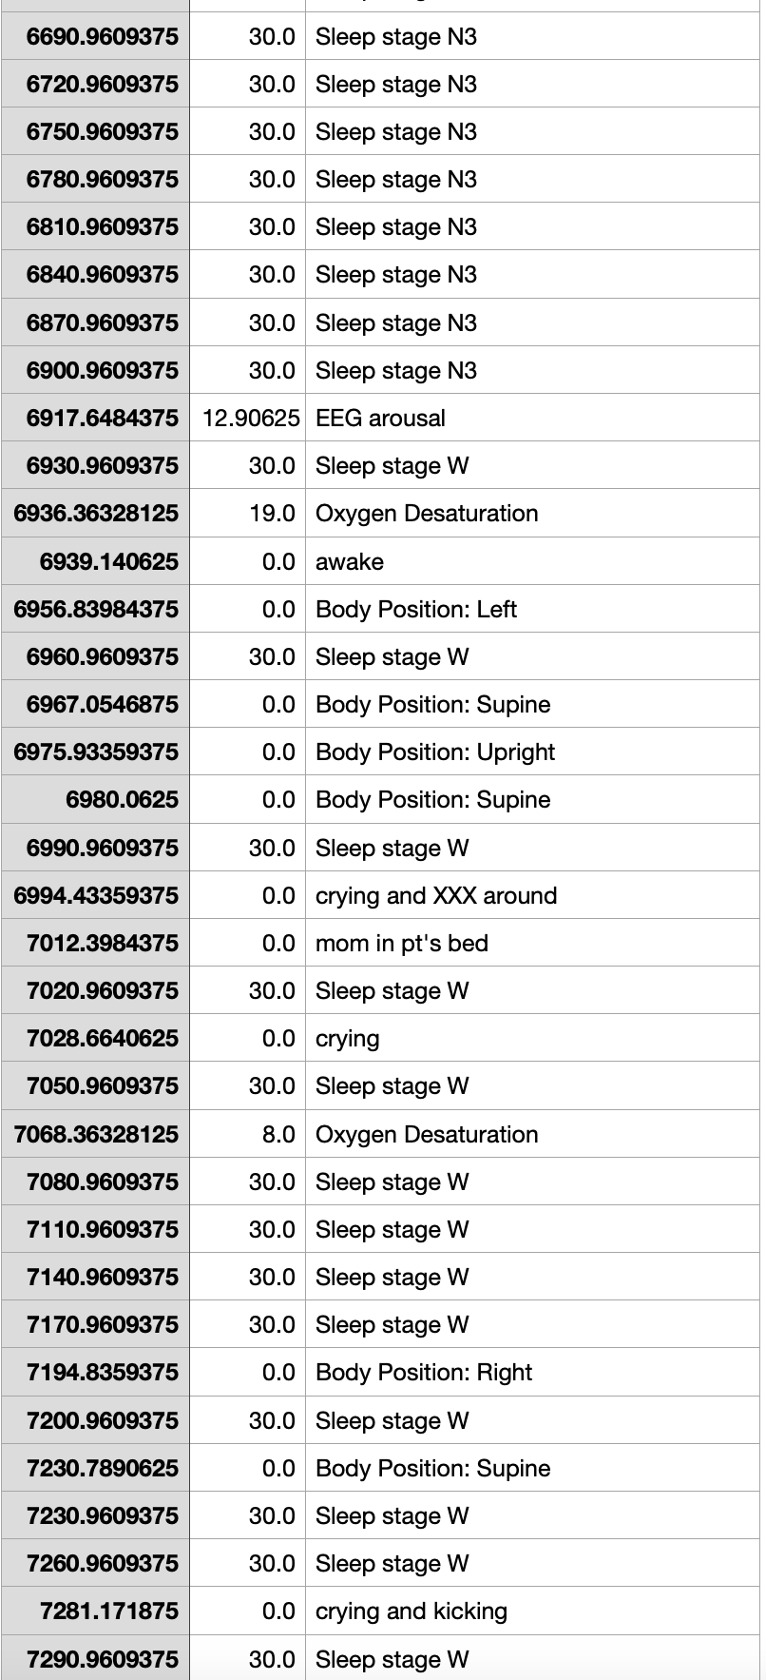
Data Update
• tsv files containing description of a patient in the sleep study
• pick up useful information such as sleep stage, hyponea and apnea

Slide 5
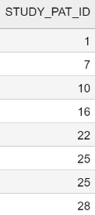
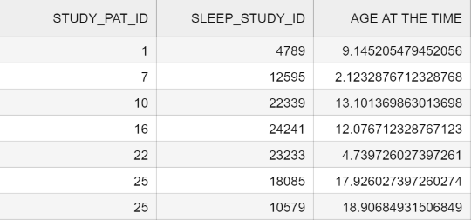
Given the amount of CSVs and variables, it is necessary to extract relevant ones and put them in a new table.
Some patients only have one sleep study done. But some patients have done it more than once.
Common key across every table.
Each ID represents a unique patient.

Slide 6
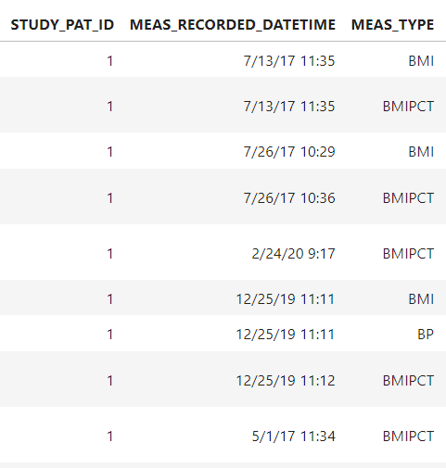
The most challenging part was the inclusion of Blood Pression and Body Mass Index because of so many repetitions for the same subject.
Each patient only needs one measurement.
The challenge is to find the most appropriate one to match patient ID.

Slide 7
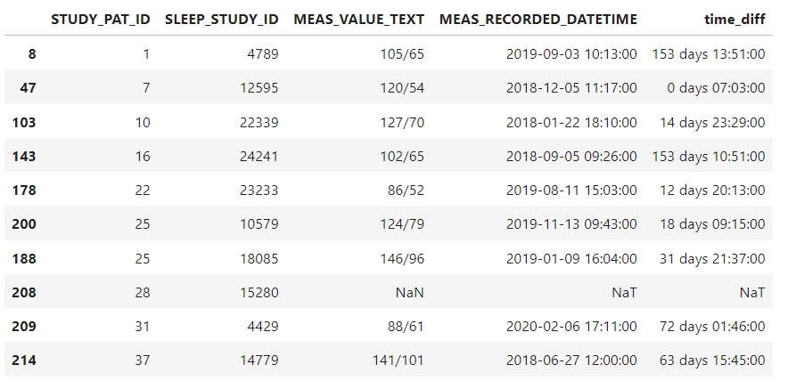
Each measurement of Blood Pressure or Body Mass Index has its time; each sleep study has its time, we merge the sleep study to the measurement that was done most recently. (Pandas group and merge did this successfully)

Slide 8
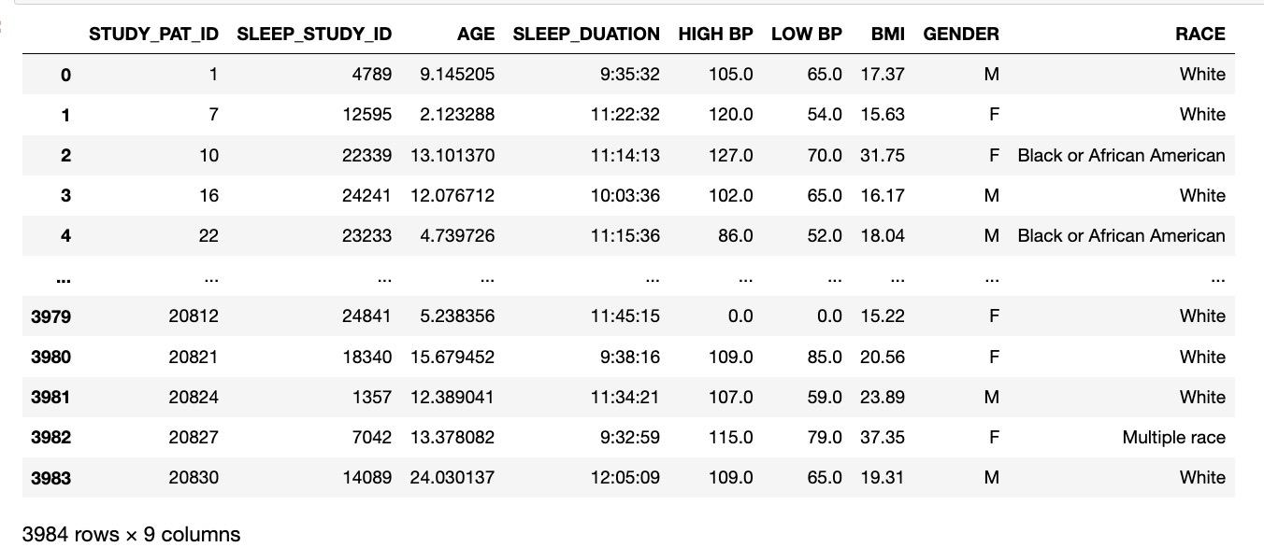
An overview of the final file.

Slide 9
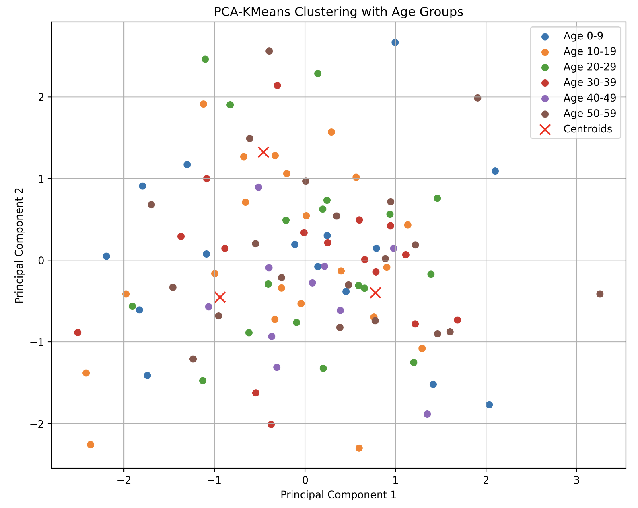
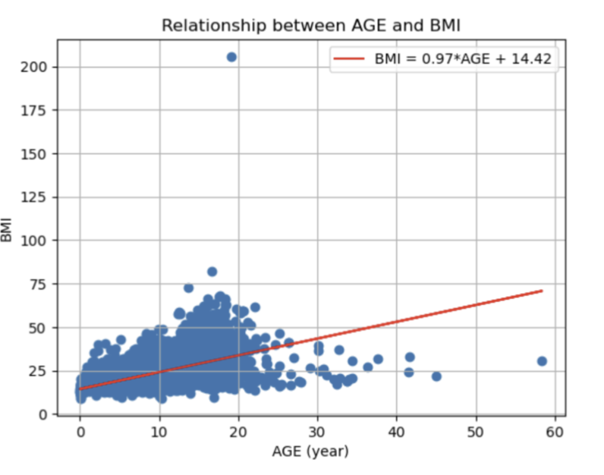
Explore potential relationship between variables
KMeans Clustering
BMI’s clustering upon variables
There is no clear relationship among Age and BMI

Slide 10
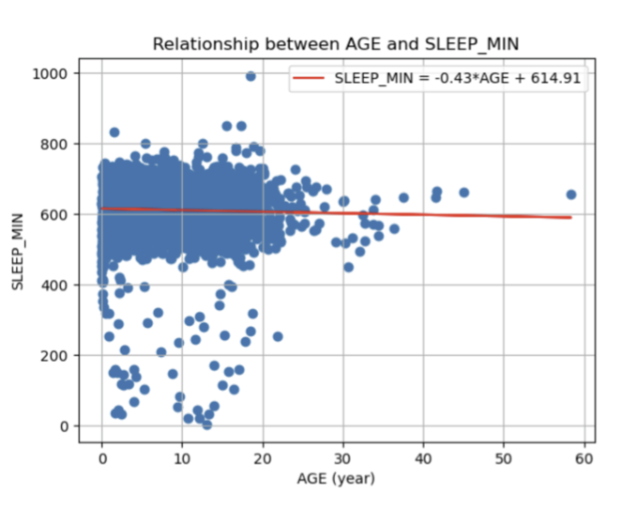
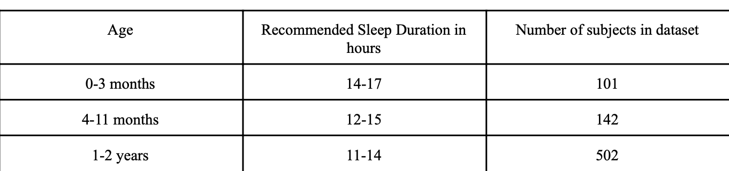
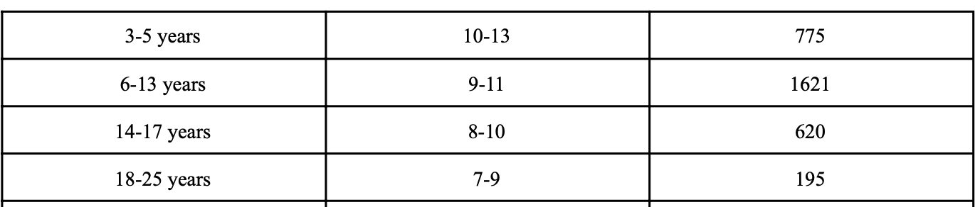
Explore potential Age criteria upon sleep study
There is no clear relationship between sleeping time and Age
Decide to use official criteria of age group by sleep duration:

Slide 11
Summarized in a combined table
Entire dataset
Health Data
Sleep Data
(EEG)
What about brain activity data?

Slide 12
EEG Baseline Processing
Global Field Power (GFP) (measure of overall brain activity patterns during different sleep stages)
Power (distribution of power across different frequency bands)
Epochs - customizable in our code.

Slide 13
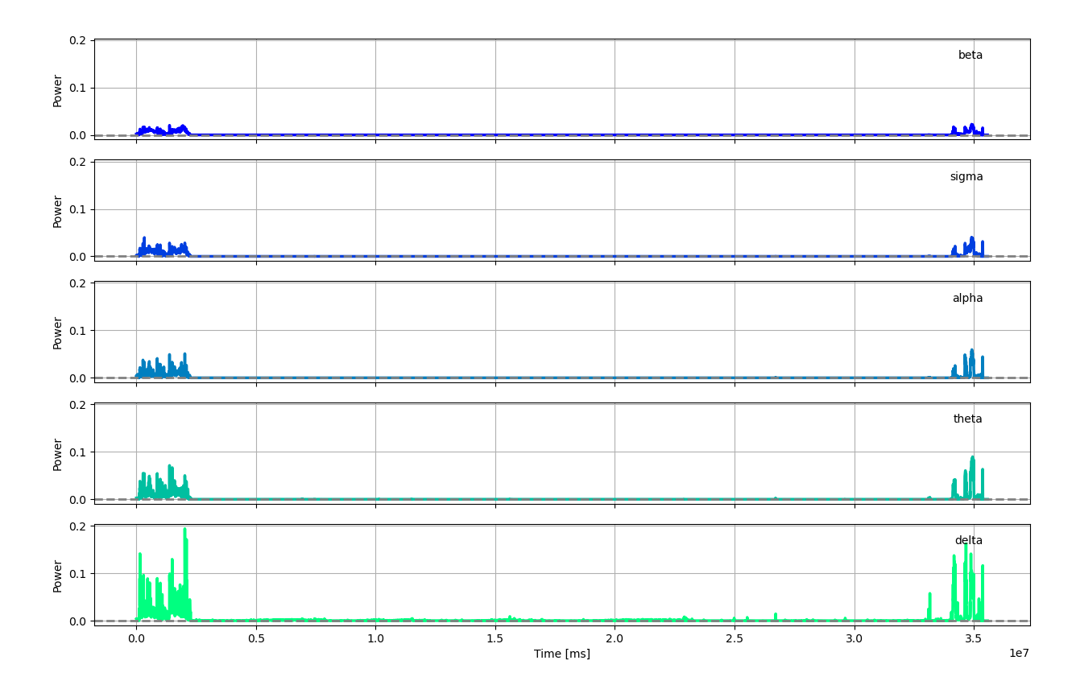
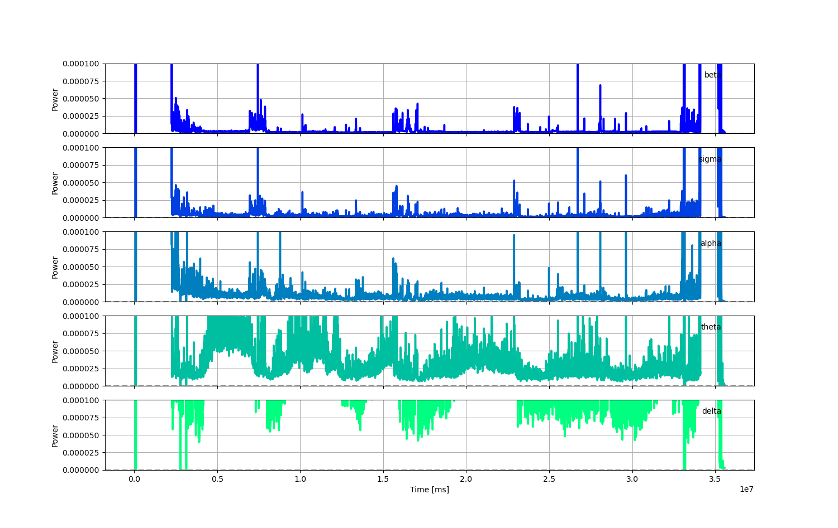
Power

Slide 14
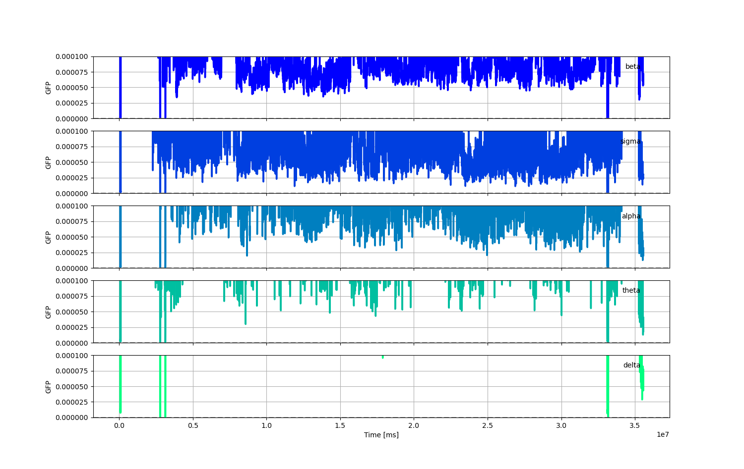
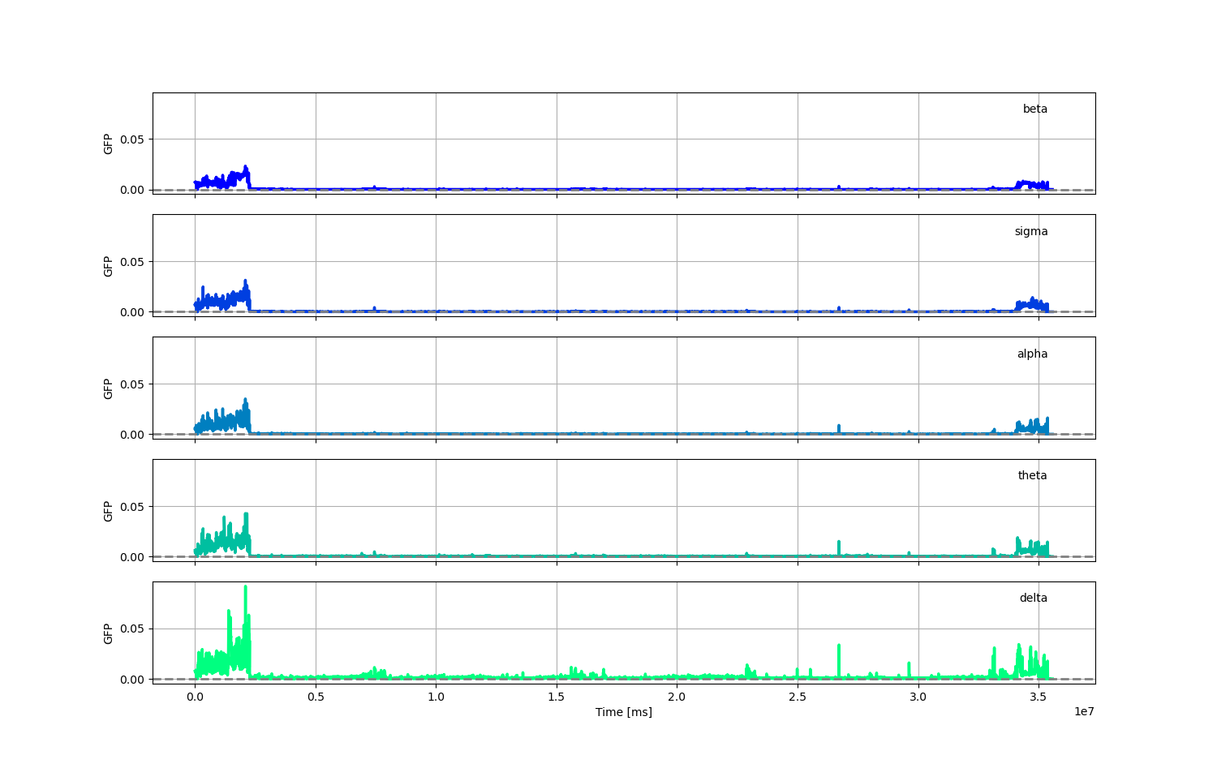
Global Field Power (GFP)

Slide 15
Data Abstraction Dictionary
1. EOG LOC-M2: Electrooculogram, measuring eye movements, specifically left outer canthus to M2 electrode.
2. EOG ROC-M1: Electrooculogram, measuring eye movements, specifically right outer canthus to M1 electrode.
3. EMG Chin2-Chin1: Electromyogram, measuring muscle activity, specifically from chin electrode 2 to chin electrode 1.
4. EEG F3-M2: EEG recording from electrode F3 to electrode M2.
5. EEG F4-M1: EEG recording from electrode F4 to electrode M1.
6. EEG C3-M2: EEG recording from electrode C3 to electrode M2.
7. EEG C4-M1: EEG recording from electrode C4 to electrode M1.
8. EEG O1-M2: EEG recording from electrode O1 to electrode M2.
9. EEG O2-M1: EEG recording from electrode O2 to electrode M1.
10. EEG CZ-O1: EEG recording from electrode CZ to electrode O1.
11. EMG LLeg-RLeg: Electromyogram, measuring muscle activity, specifically from left leg electrode to right leg electrode.
12. ECG EKG2-EKG: Electrocardiogram, measuring heart activity, specifically from electrode EKG2 to EKG electrode.
13. Snore: Detection of snoring sounds.
14. Resp PTAF: Respiratory signal, possibly measuring airflow.
15. Resp Airflow: Measurement of airflow during respiration.
16. Resp Thoracic: Respiratory signal, specifically measuring thoracic movement.
17. Resp Abdominal: Respiratory signal, specifically measuring abdominal movement.
18. SpO2: Measurement of blood oxygen saturation.
19. Rate: Heart rate measurement.
20. EtCO2: Measurement of end-tidal carbon dioxide concentration.
21. Capno: Measurement of carbon dioxide concentration.
22. Resp Rate: Measurement of respiratory rate.
23. C-flow: Measurement of airflow.
24. Tidal Vol: Measurement of tidal volume (the amount of air moved in or out of lungs during breathing).
25. Pressure: Possibly a measurement of airway pressure

Slide 16
Timeline
EEG Processing (finish all files by end of spring break)
Batch processing of EDF files, with further addition to each patient profile.
Determine the best epoch value for time window in EDF analysis.
Sleep Apnea (by end of this week 3/10)
Determine criteria for forest model with official source
Identify unsupervised methods that we will use to run a comparison between official criteria vs what the data will tell us.

Slide 17
Timeline
EEG & Sleep Apnea (first week of April)
Build a neurophysiological profile of each age group based on processed data.
Begin analysis for Sleep Apnea - readjust techniques if there are difficulties.
Provide raw report (sleep apnea) on at least 3 age groups.
Continue EDF processing (if still any left)
Last weeks of april
All EDFs are processed, sleep apnea analysis performed.
If time left - attempt insomnia.

Slide 18

Questions?

